Slide 1
Project:
Biosponge

Slide 2
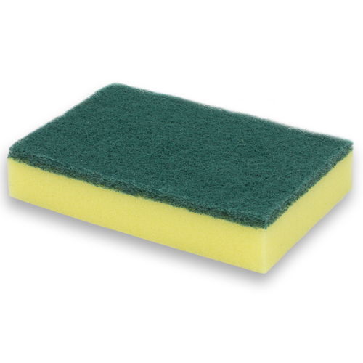

Slide 3
Swot analysis
Widely used for cleaning
Various shapes
Affordable
Dirty
Similarity
Not environmentally friendly
S
W
O
T
Be adapted for different uses
Demand for eco-friendly products
New technologies (Robotics)
Pandemic trend decline
S
W
O
T

Slide 4
SWOT analysis

Slide 5
Widely used for cleaning
Various shapes
Affordable
S
W
O
T

Slide 6
Gets dirty
Similarity
Not environmentally friendly
S
W
O
T

Slide 7
Can be adapted for different uses
Demand for eco-friendly products
S
W
O
T

Slide 8
New technologies (Robotics)
Pandemic trend decline
S
W
O
T

Slide 9
Their weakness is our opportunity
Easy to get dirty
Similar product on the market
Not environmentally friendly

Slide 10
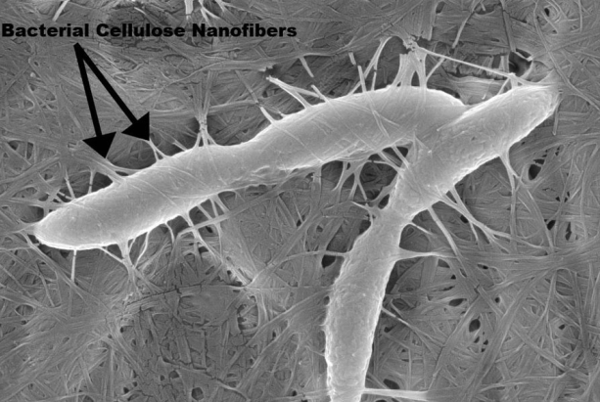
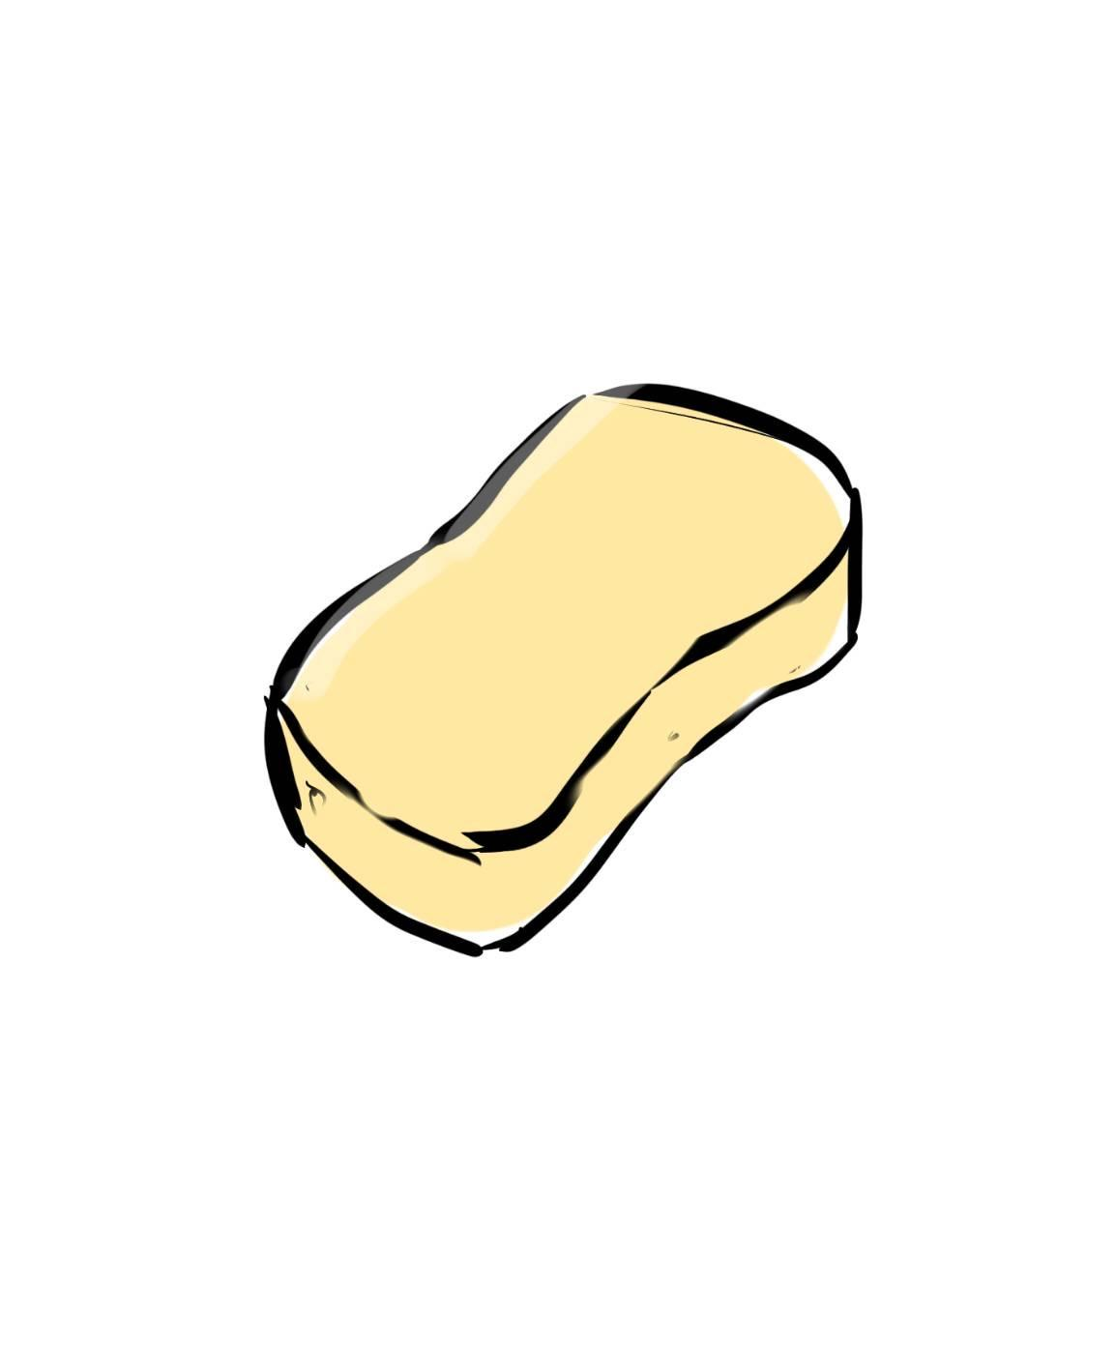
Our idea: Biosponge

Slide 11
High Environmental friendliness
Bio-
sponge
Cellulose sponges
Easy to get dirty
Hard to get dirty
Plastic sponges
Low Environmental friendliness

Slide 12
Benefits:
No need cleaning liquid
Can be broken down easily
Can regenerate

Slide 13
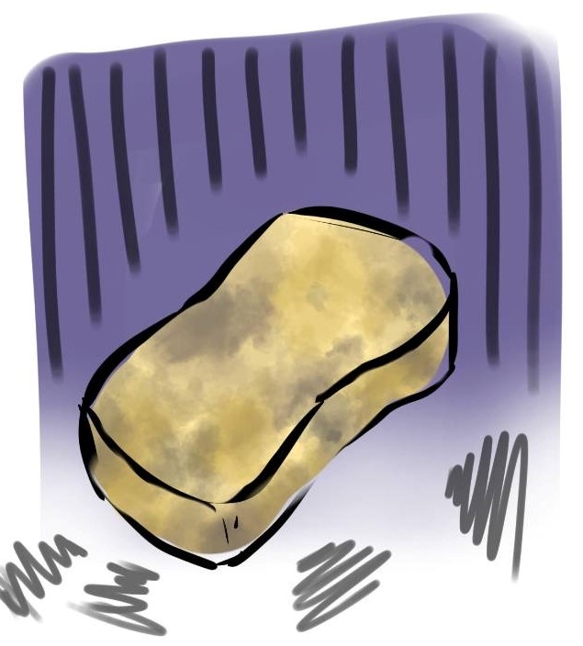

few days later

Slide 14
“Clean your space
Clear your mind
Care the environment”
Thank you

